Slide 1
Overview of Intellectual Property Rights
Notes:
Kosgei2008
1

Slide 2
Introduction
The emergence of the Internet has caused policymakers, legislators, rights holders, content creators, businesses, content users and others to rethink the way intellectual property should operate in a modern inter-connected society.
The range of new technologies and the speed of innovation raises intellectual property issues: domain names are often inextricably linked with trademark issues; and the ease with which digital technologies allow for copying and distribution challenges copyright law enforcement.

Slide 3
introduction
Intellectual property is currently at the center of an international debate in many different forums regarding how to reconcile the potential of the Internet with traditional intellectual property approaches, including how to stop unlawful transactions on the Internet.
Two principal approaches have emerged: involving Internet intermediaries in enforcement and using Internet technical measures to prevent access to unauthorised content.

Slide 4
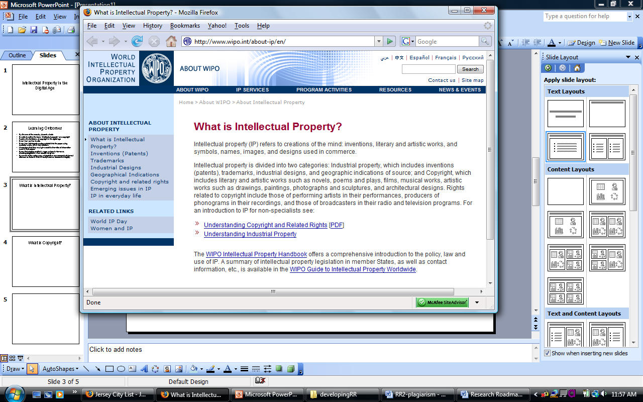
Introduction to IP

Slide 5
The need for… ... Protecting Private property
Incentive to create:
The economic philosophy behind the legislations empowering States to grant IP rights is the conviction that encouragement of individual efforts by direct personal gains is the best way to advance public welfare through the talents of authors and inventors in Science and useful Art^{”1}.
¹US Supreme Court in Mazer v Stein (1954)

Slide 6
The need for… ... Protecting Private property
Works against the ‘lazy’ in you!
It prevents free riding on works or reputation of others and
Frees your creative mind
Prevents possible holdout of life enriching ideas from learned and ingenious minds.

Slide 7
In sum:
Why Protect your Intellectual Property?
Incentive to create
Prevent unjust enrichment
Prevent “hold out” of life enriching ideas

Slide 8
Cont/. Legal basis of Protecting IP
Domestic Obligations:
The Constitution of Kenya:
The fundamental rights in the Constitution provide every person with the right to property; which must be understood to also include intellectual property.
It provides:- Sec.75. (1) No property of any description shall be compulsorily taken possession of, and no interest in or right over property of any description shall be compulsorily acquired, except where the following conditions are satisfied…..

Slide 9
Different aspects of IP
Type of IP IP Rights
Inventions Patents
works of Art and Authorship Copyright
Source identification/Brand names Trademarks
Aesthetics/Ornamental features Designs
Proprietary information Trade secrets

Slide 10
PATENT
What is a Patent?
A Patent is a legal document granted by a State that secures to the holder, for a limited period, the right to exclude others from making, using, selling, offering for sale, and importing the patented subject matter

Slide 11
Patentable subject matter
Any new and useful process, product, composition of matter, or any improvement thereof, may be patented, on condition that such invention is:
Novel
involves an inventive step i.e must not be obvious to a person of ordinary skills in that field of art, and
industrially applicable

Slide 12
What is not Patentable?
Discoveries or findings that are products or processes of nature, where mankind has not participated in their creations
Scientific theories and mathematical methods
Schemes, rules or methods of doing businesses or playing games or purely performing mental acts.

Slide 13
Cont/. What is not Patentable?
Methods of treatments of both human and animals by surgery or therapy as well as diagnostic methods practice thereto, except products for use thereof.
Inventions contrary to public order, morality, public health and safety, principles of humanity and environmental conservation

Slide 14
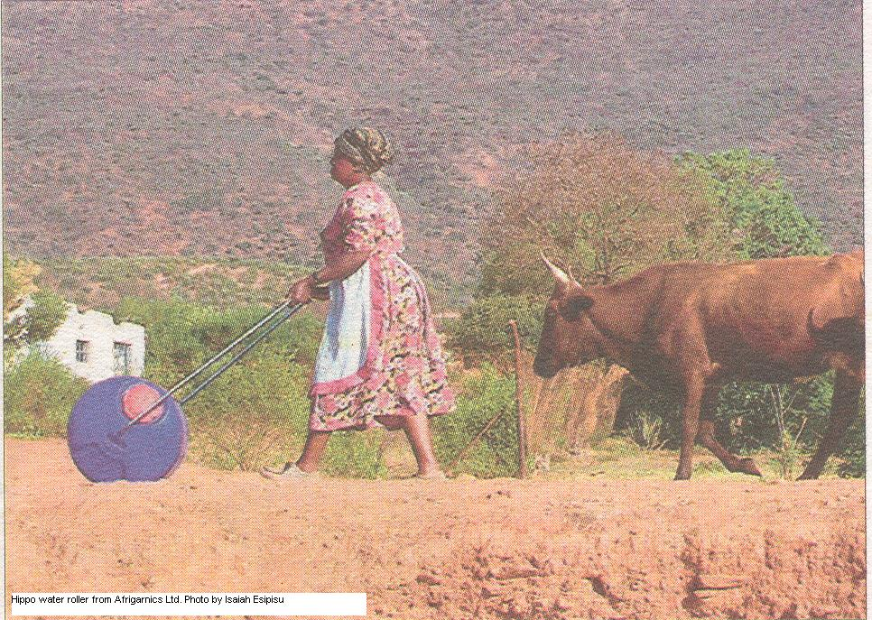

Examples

Slide 15
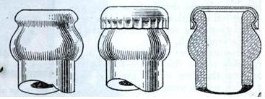
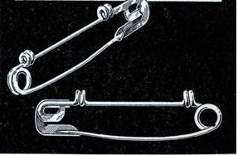
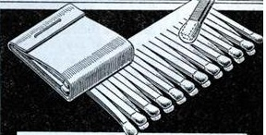
More Examples

Slide 16
COPYRIGHT
What is Copyright?
Simply is “the right to make copies”
Copyright protection subsist in any original works of art and authorship once fixed in any tangible medium of expression, from which they can be perceived, reproduced, or otherwise communicated, either directly or with the aid of a machine or device
A cautionary Note!
Copyright only extent as much to the expressions of and NOT to the underlying ideas or facts.

Slide 17
Copyrights
“Copyright is a legal device that provides the creator of a work of art or literature, or a work that conveys information or ideas, the right to control how the work is used."

Slide 18
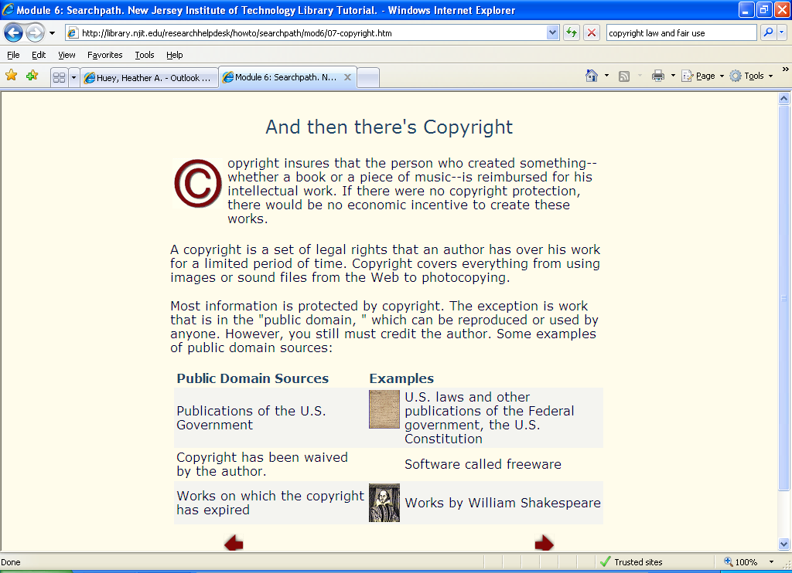
Copyrights

Slide 19
Why Protect your Copyright?
19
Economic rights:
Incentive to create
Prevent unjust enrichment
Prevent “hold out” of life enriching ideas from learned and ingenious minds
Moral rights:
The Rights to claim authorship
The Right to object to any distortion, mutilation nor other actions defacing the original work

Slide 20
Subject matter of Copyright
Literary works which include:-
novels, stories and poetic works,
plays, stage directions, film sceneries and
broadcasting scripts,
textbooks, treatises, histories, biographies, essays and articles;
encyclopedias and dictionaries,

Slide 21
Cont/. Subject matter of Copyright
Artistic works, which include:-
paintings, drawings, etchings, lithographs, woodcuts, engravings and prints,
maps, plans and diagrams,
works of sculpture,

Slide 22
Cont/. Subject matter of Copyright
photographs not comprised in audio-visual works,
works of architecture in the form of buildings or models, and
work of artistic craftsmanship, pictorial woven tissues and articles of applied handcraft and industrial art;

Slide 23
Cont/. Subject matter of Copyright
Musical works which includes:-
Dramatic works, including any music
Pantomimes
choreographic
Audio-visual works,
Sound recordings, and
Broadcasts.

Slide 24
What does copyright protect?
Copyright law protect the author of work against wilful acts of:
Copying, reprinting, publishing and vending the copyrighted work
Displaying, delivering, reading or presenting copyrighted work in public
Performing publicly e.g drama, musical composition
Producing and distributing to the public
Adapting, compiling, arranging, dramatizing translating or any other version of copyrighted works in public

Slide 25
Exemptions (Fair use doctrine)
Use of the works for educational and scientific purposes
Private use
Criticism or review
Reporting of current events subject to acknowledgement of the source

Slide 26
Requirements for copyright Protection
Originality
Independent creation
modest quantum of creativity
Fixation
Works of authorship(intangible)
Material object

Slide 27
TRADEMARK
What is a Trademark?
is a distinctive sign, used by a merchant to identify its goods or services and to distinguish them from those produced or provided by others.

Slide 28
Cont/Subject matter of Trademark?
It includes any distinctive sign: word, letter, slogan, device, brand-name, heading, label, ticket, name, signature or numeral or any combination thereof, whether in 2D or 3D form.
some countries allow registration of: single colours, audible signs(sounds) or olfactory signs (smells), Holograms, Scent or even Motion signs.

Slide 29



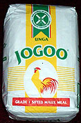
Words | “Yes” is a registered mark of Kencell Communications Limited. | “JOGOO” is a registered mark of Unga Limited
Device | The device is a registered mark of Nation Media Group. | The wind mill device is a registered mark of Unga Limited

Slide 30




Combinations Of letters with devices | “KTN” is a registered mark of the Standard Group | “KCB” is a registered mark of Kenya Commercial Bank
Three-dimensional marks: | The contour device of a bottle is a registered mark of Coca Cola Company

Slide 31


Slogan | “the pride of Africa” is a mark of Kenya Airways. | MY COUNTRY MY BEER “MY COUNTRY MY BEER” is a mark of East Africa Breweries Limited.
Numerals | “0722” is a registered mark of Safaricom limited | 504 “504” is a mark of Automobiles Peugeot of France

Slide 32
Why protect your trademark?
Registration gives your company the right to exclude others from marketing identical or similar products under an identical or a confusingly similar mark.

Slide 33
What are trademarks for?
To the producers:
Enables companies to differentiate their products
Is a marketing tool and the basis for building brand image and reputation
Encourage companies to invest in maintaining product quality
a valuable business asset
May be licensed to provide a direct source of revenue through royalties
is a critical element in franchising agreements
Can be use as collateral for obtaining financing

Slide 34
Cont/ What are trademarks for?
To the Consumers:
Ensure that consumers can identify the origin of products
Aid consumers in distinguishing between products from different manufacturers
Acts as an indication of quality
Acts as an assurance of genuineness
Source of information

Slide 35
INDUSTRIAL DESIGN
What is an Industrial Design?
an industrial design refers to the ornamental or aesthetic features of a product. In other words, it refers only to the appearance of a product and NOT the technical or functional aspects.

Slide 36
Subject matter of Industrial Designs
Any products of industry: fashions, handicrafts, technical and medical instruments, watches, jewellery, household products, toys, furniture, electrical appliances, cars; architectural structures; textile designs; sports equipment; packaging; containers and “get–up” of products
Notes:
Kosgei2008
36

Slide 37
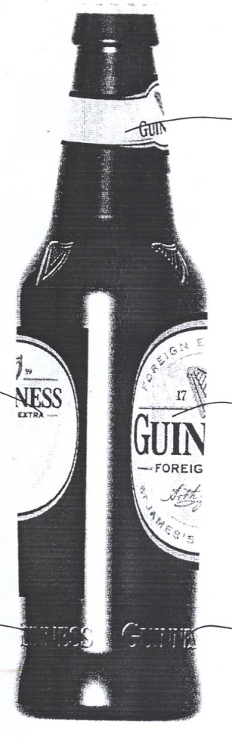
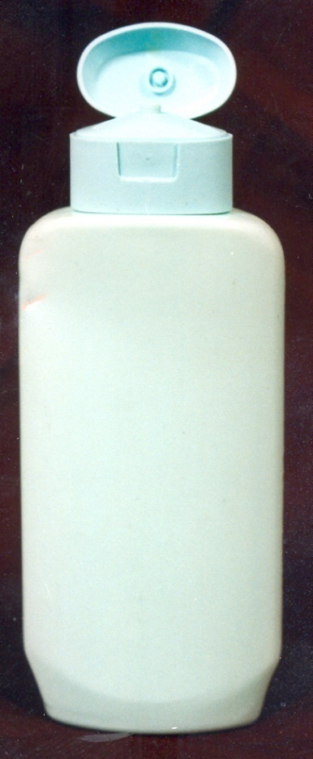
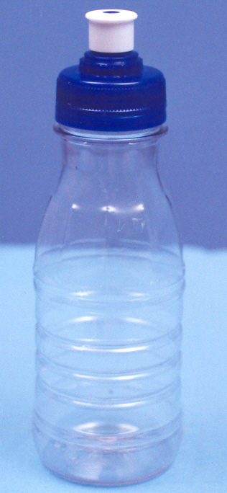
Examples of Industrial Designs

Slide 38
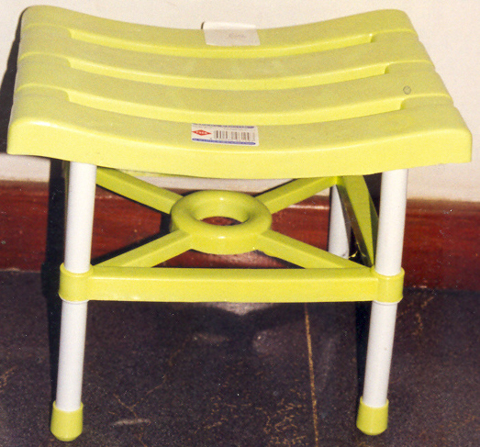
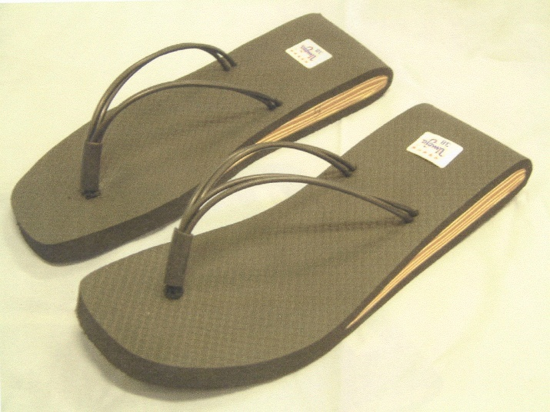
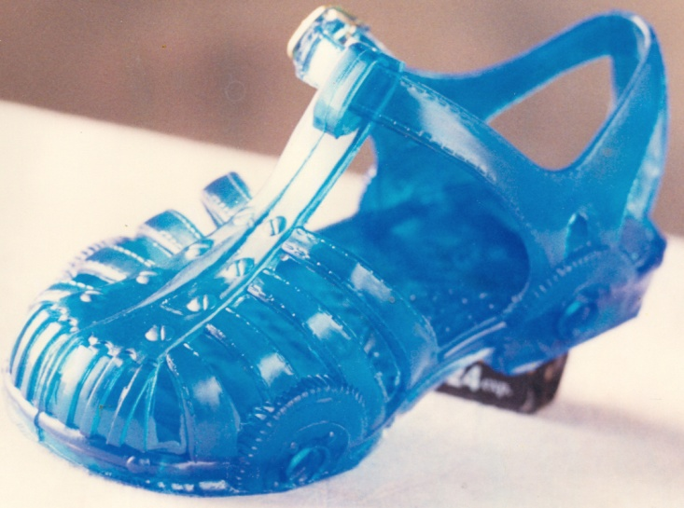
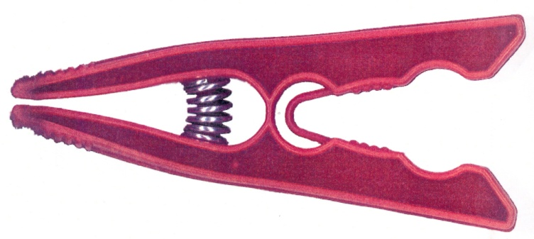
Examples of Industrial Designs

Slide 39

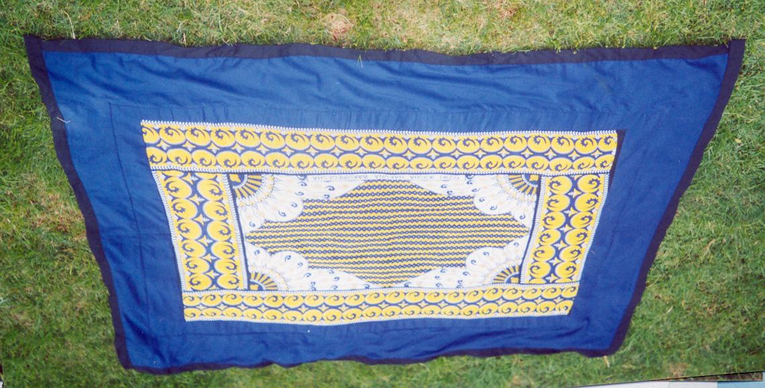
Examples of Industrial Designs

Slide 40
Importance of Industrial Designs in Business
Customize products to appeal to specific market segments
Create a new niche market.
Strengthen their brands images.
It adds value to a product.

Slide 41
Why protect an ID?
the creator is granted the exclusive right to prevent others from unauthorized copying, imitating, making, selling, or importing any product in which the design is incorporated or to which it is applied

Slide 42
Requirements for ID registration
New
Original – independently created
Design must have “individual character” – when overall impression is evaluated against others.

Slide 43
TRADE SECRETS
What are trade Secrets?
Is any information that can be used in the operation of a business or other enterprise and that is sufficiently valuable and secret to afford an actual or potential economic advantage over others.

Slide 44
Subject matter of Trade Secrets
It includes; formulae, pattern, compilation, data, devices, methods, techniques, or processes

Slide 45
Requirements for protecting Trade Secret
Subject matter must not be generally known or available
Affirmative measures must be in place to safeguard them
Must be of sufficient economic value or competitive advantage
But secrecy is the most important- a sin qua non

Slide 46
Problems from New Technologies That Affect Intellectual Property Owners
High-quality copying.
High-quantity distribution.
Easier to use.
Less expensive.

Slide 47
Technology, Markets and Management, and Regulations and Enforcement
Technological Solutions:
Expiration date encoded.
Hardware dongle required.
Copy-protection schemes.
“Activation” features.
Encryption schemes; digital-rights management (DRM).

Slide 48
Technology, Markets and Management, and Regulations and Enforcement
Markets and Management:
Subscribe to services.
Collect fees from users and large organizations.
Meter usage of intellectual property on a network.
Offer discounts to educational users.
Educate the public about the value of intellectual property belonging to creators and publishers.

Slide 49
Technology, Markets and Management, and Regulations and Enforcement
Regulations and Enforcement:
The Digital Millennium Copyright Act (DMCA) and other laws.
Identify abusers and shut them down in high-publicity raids.
Monitor abuses.
Enforce current laws and punish abusers.

Slide 50
Restrictions and Bans on Technology
In the past, lawsuits have delayed, restricted, or banned the release of new technologies, including:
CD-recording devices.
Digital Audio Tape (DAT) systems.
DVD recorders.
DVD players.
MP3 players.
In an attempt to reduce or prevent unauthorized copying and distribution of intellectual property, some governments have levied taxes on:
Audio tapes, CD recorders, Personal computers, Printers.
Scanners.

Slide 51
END

